Slide 1
College Football Bowl Pool Website

Slide 2
What is it?
Excel sheet with college football bowl matchups sent to family members
Everyone sends back a copy and grandfather combines into a master spreadsheet
Grandfather manually updates who won the games
Grandfather manually adds the points of games won to declare a winner
Create a website that can display the spreadsheet and automatically update

Slide 3
Main Functionality
Parses input spreadsheet
Retrieves football game data from 3rd party API
Display data on a webpage

Slide 4
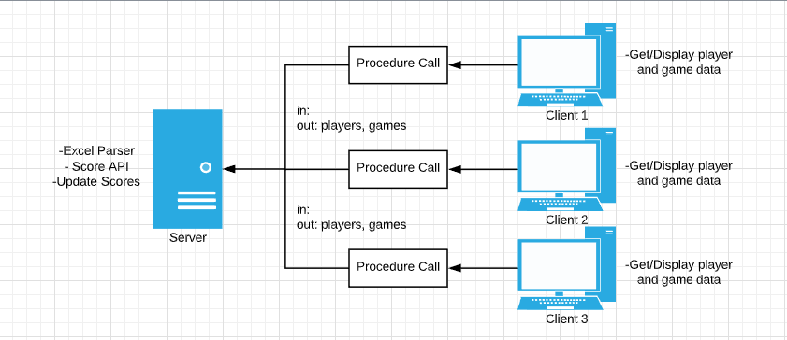
Style 1 - Client Server
Level 2 diagram

Slide 5
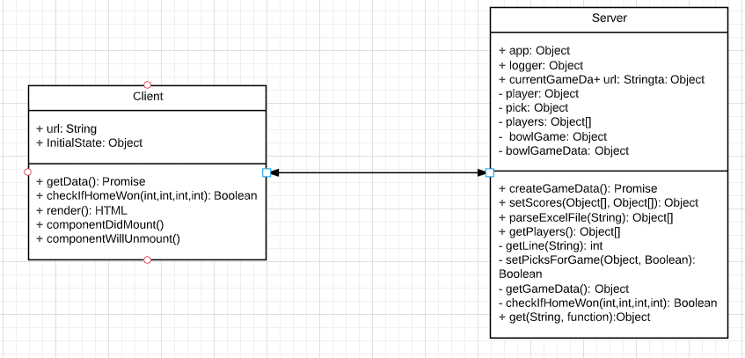
Style 1 - Client Server
UML Diagram

Slide 6
Client Server
Pros
- Easy to build the base functionality
- Scalable
Cons
- Does not allow for easy upgradability

Slide 7
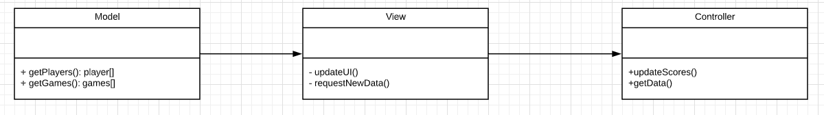
Style 2 - Model View Controller
Level 2 Diagram

Slide 8
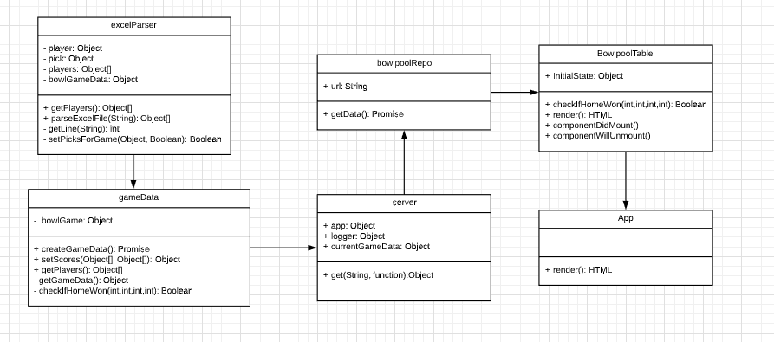
Style 2 - Model View Controller
UML Diagram

Slide 9
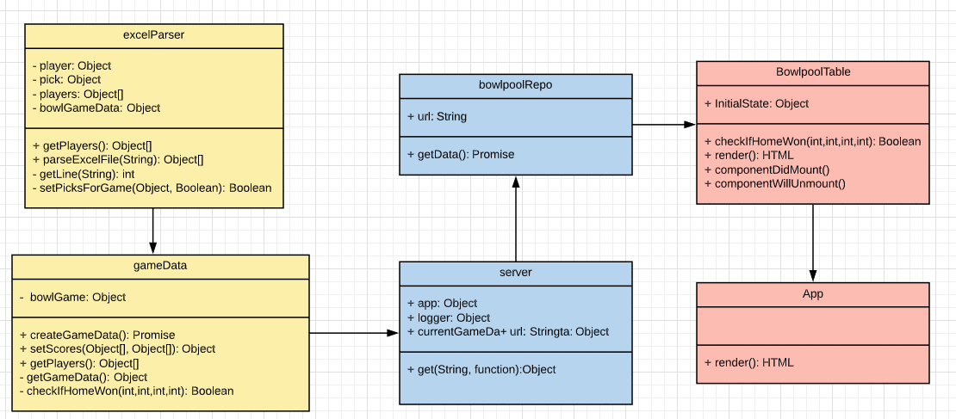
Style 2 - Model View Controller
Mapping

Slide 10
Model View Controller
Pros
- Allows for minimal refactoring after adding components
- Multiple views for one model and controller
Cons
Increased complexity for this project
Can have a mobile view / desktop view

Slide 11
MVC Selected
Client-Server does not allow for major changes later on
MVC allows for me to add additional functionality in the future

Slide 12

DEMO

